Slide 1
Introduction to Information Systems and Programming
Design Patterns II –
Visitor

Slide 2
Outline
Visitor Pattern
Abstract Factory Pattern
Proxy Pattern
Flyweight Pattern
State Pattern
Cohort Exercises …

Slide 3
Visitor
Useful if you need to perform operations across a diverse set of objects
GoF: “Allows for one or more operation to be applied to a set of objects at runtime, decoupling the operations from the object structure”
Provide additional functionality to a class without changing it

Slide 4
Example: Postage
Postage calculation depends on the item type:
Book
CD
Clothing
Also depends on where the item is sent to
Given a list of items of variety types, determine the total postage cost

Slide 5
Non-visitor design
public static double calPostage(ArrayList<Object> items) {
double total=0;
for (Object o: items) {
if (o instanceof Book) {
...
}
else if (o instanceof CD) {
...
}
else if (o instanceof Clothing) {
...
}
else
throw new AssertionError("not supported");
}
return total;
}
-Another procedure for another region

Slide 6
Visitor Design Pattern is a more OO way to perform operation on a list of items
Non-Visitor Design:
…
Item1
Item2
Item3
processing()
Visitor Design:
Visitor
(An object of processing)
…
Item1
Item2
Item3

Slide 7
Visitor Design Pattern
Visitor
Visitable
+visit(Item1)
+visit(Item2)
+accept(Visitor)
Item1
accept(Visitor v):
v.visit(this)
ConcreteVisitor
visit(Item1):
// processing for Item1
visit(Item2):
// processing for Item2
Item2
visit()
accept(Visitor v):
v.visit(this)

Slide 8
Visitor Design Pattern: Visitor Interface
// Visitor.java
public interface Visitor {
void visit(Book b);
void visit(CD c);
void visit(Clothing c);
}
-Different visit methods for different object types to be processed
-Later, use method overloading to pick the method for processing (instead of if-then-else)

Slide 9
PostageVisitor.java : concrete class implements Visitor
public class PostageVisitor implements Visitor {
private double total =0;
@Override
public void visit(Book b) {
total += b.getWeight() * 5;
}
@Override
public void visit(CD c) {
...
}
}
-Concrete implementation of Visitor provides the specifics of what to do with different object types

Slide 10
Visitable Interface
public interface Visitable {
void accept(Visitor v);
}
- Allows the Visitor to be passed in

Slide 11
Item implements Visitable
class Book implements Visitable {
private double weight;
public void accept(Visitor v) {
v.visit(this);
}
public Book (double weight) {
this.weight=weight;
}
public double getWeight() {
return weight;
}
}
Simple but important change to make a class visitable:
dispatch of visit depends on data type “this”

Slide 12
Test.java
ArrayList<Visitable> items = new ArrayList<Visitable>();
PostageVisitor postage = new PostageVisitor();
items.add(new Book(1));
items.add(new CD("psy"));
items.add(new Book(2));
items.add(new Clothing(10));
for (Visitable o: items){
o.accept(postage);
}
System.out.println(postage.getTotal());
Visitor postage visits each item one by one, processes them, information kept inside visitor

Slide 13
Advantage of Visitor
Separate out certain logic (e.g., postage calculation) from the items themselves, keeping the item classes simple
Item classes only need to implement Visitable
Add methods to classes: another concrete class implements Visitor
No need to change item classes
Enable static checking: code cannot be compiled without the visit method of the corresponding type

Slide 14
Cohort Activity
Use the Visitor design pattern, compute the total tax income of a list of items of the following types: Car, Electronics, Chocolate. Two taxing systems are in place:
TaxNormal:
Car: 40%, Electronics: 80%, Chocolate: 20%
TaxHoliday:
Car: 30%, Electronics: 50%, Chocolate: 10%

Slide 15
Abstract Factory
Abstract Factory is one of the most used design patterns
Builds on Factory design pattern
GoF: “Provide an interface for creating families of related or dependent objects without specifying their concrete classes”
We create objects and object creator factories without exposing creation logic to the clients and refer to newly created objects and factories using a common interface

Slide 16
Abstract Factory - Example
We have a class named SomeApp that depends on the interface Shape.
Shape uses instances of Shape solely through the Shape interface.
Problem: SomeApp also creates instances of Square and Circle and thus has to depend on the concrete classes.

Slide 17
Abstract Factory - Example
Solution: ShapeFactory interface.

Slide 18
Abstract Factory
Intent: Provide an interface for creating families of related or dependent objects without specifying their concrete classes.
Applicability - Use the Abstract Factory pattern when
1) Independence from Initialization or Represenation:
The system should be independent of how its products are created, composed or represented
2) Manufacturer Independence:
A system should be configured with one of multiple family of products
You want to provide a class library for a customer (“facility management library”), but you don’t want to reveal what particular product you are using.
3) Constraints on related products
A family of related products is designed to be used together and you need to enforce this constraint
4) Cope with upcoming change:
You use one particular product family, but you expect that the underlying technology is changing very soon, and new products will appear on the market.

Slide 19
Example: Components and Boards
Possible objective: layout on a GUI for circuit layout and simulation:
Components: resistors, capacitors, diodes
Boards: Vero board, Bread board, PCB
Demonstrates need for different types of factories but common rendering and layout in design and simulation

Slide 20
Non - pattern design
Design each component by itself
Design each board by itself
Repeat design of component type constructor
Repeat design of board type constructor
Repeat design for each new component and board
…

Slide 21
Factory Design Pattern
<<interface>>
Component
+draw()
DesignDemo
implements
asks
Diode
creates
ComponentFactory
Resistor
Capacitor
+ draw()
+getComponent(“Resistor”)
Resistor
+ draw()

Slide 22
Abstract Factory Design Pattern
AbstractFactory
Factory Producer
abstract getComponent
(String c)
abstract getBoard(String b)
af = new ComponentFactory();
AbstractFactory Pattern Demo
uses
uses
extends
extends
Component Factory
Board Factory
creates
creates
<<interface>>
<<interface>>
Component
Board
+place ()
+configure()
implements
implements
Resistor
Capacitor
Diode
VeroBoard
BreadBoard
PrintedCircuit Board
+place ()
+place ()
+place ()
+configure()
+configure()
+configure()

Slide 23
Proxy Pattern Motivation
Goal:
Prevent an object from being accessed directly by its clients
Solution:
Use an additional object, called a proxy
Clients access to protected object only through proxy
Proxy keeps track of status and/or location of protected object

Slide 24
Proxy Pattern - Motivation
What is expensive?
Object Creation
Object Initialization
Defer creation and initialization to the time you need the object
Reduce the cost of access to objects
Use another object (“the proxy”) that acts as a stand-in for the real object
The proxy creates the real object only if the user asks for it
Source: Chapter 6 – Design Patterns

Slide 25
Uses of the Proxy Pattern
Virtual proxy: impose a lazy creation semantics, to avoid expensive object creations when strictly unnecessary.
Monitor proxy: impose security constraints on the original object, say by making some public fields inaccessible.
Remote proxy: hide the fact that an object resides on a remote location; e.g. the RemoteLogClient is essentially a remote proxy for a LocalLog.

Slide 26
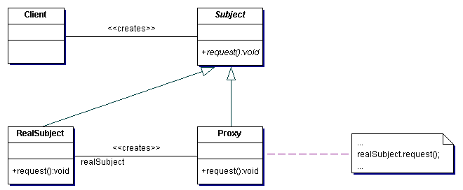
Proxy Pattern - Structure
Intent
Provide a surrogate or placeholder for another object to control access to it.
Problem
You need to support resource-hungry objects, and you do not want to instantiate such objects unless and until they are actually requested by the client.
Structure
Source: Chapter 6 – Design Patterns

Slide 27
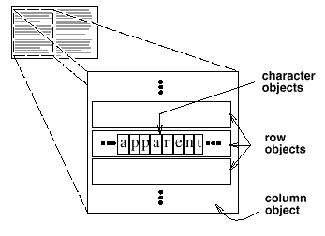
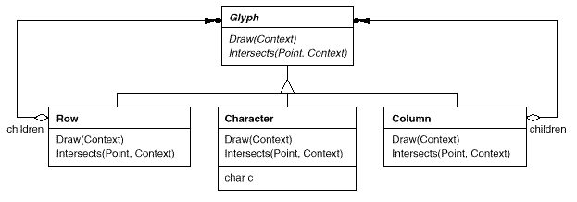
Flyweight Pattern - Motivation
How can a document editor use objects to represent characters?
The drawback of such a design is its cost.
Even moderate-sized documents may require hundreds of thousands of character objects, which will consume lots of memory and may incur unacceptable run-time overhead.
The Flyweight pattern describes how to share objects to allow their use at fine granularities without prohibitive cost.
A flyweight is a shared object that can be used in multiple contexts simultaneously.
Source: Chapter 6 – Design Patterns

Slide 28
Flyweight Pattern – Example
consider a DataPoint object
Suppose you need to create a million of these objects
class DataPoint {
private static int count = 0; private int id = count++; private int i; private float f;
public int getI() { return i; } public void setI(int i) { this.i = i; } public float getF() { return f; }
public void setF(float f) { this.f = f; } public String toString() {return "id: " + id + ", i = " + i + ", f = " + f;}
}
public class ManyObjects {
static final int size = 1000000;
public static void main(String[] args) {
DataPoint[] array = new DataPoint[size];
for(int i = 0; i < array.length; i++) array[i] = new DataPoint();
for(int i = 0; i < array.length; i++) { DataPoint dp = array[i]; dp.setI(dp.getI() + 1); dp.setF(47.0f); }
System.out.println(array[size -1]);
}
}
This program may result in excessive slowness or running out of memory.
Source: Chapter 6 – Design Patterns

Slide 29
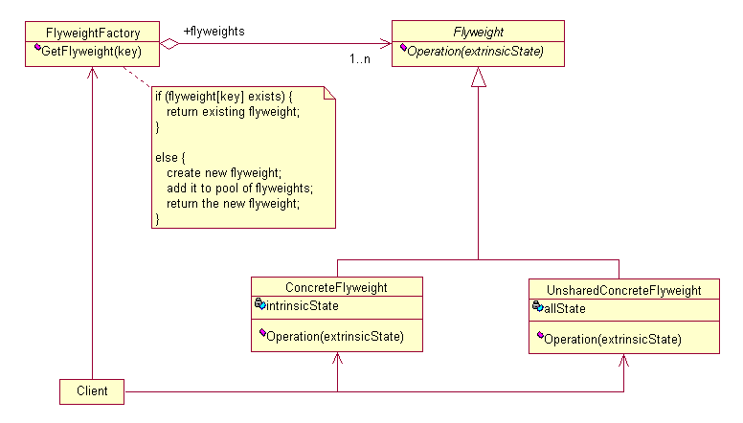
Flyweight Pattern - Structure
Intent
Use sharing to support large numbers of fine-grained objects efficiently.
Structure
Source: Chapter 6 – Design Patterns

Slide 30
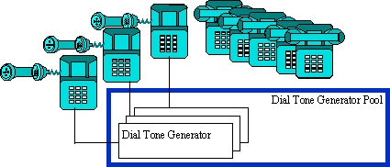
Flyweight Pattern – Example
The Flyweight uses sharing to support large numbers of objects efficiently
Example: The public switched telephone network
There are several resources such as dial tone generators, ringing generators, and digit receivers that must be shared between all subscribers.
A subscriber is unaware of how many resources are in the pool when he or she lifts the handset to make a call.
All that matters to subscribers is that a dial tone is provided, digits are received, and the call is completed.
Source: Chapter 6 – Design Patterns

Slide 31
State pattern
Suppose an object is always in one of several known states
The state an object is in determines the behavior of several methods
Could use if/case statements in each method
Better solution: state pattern

Slide 32
State pattern
In the State pattern, we create objects which represent various states and a context object whose behavior changes as its state object changes.

Slide 33
State pattern
Have a reference to a state object
Normally, state object doesn’t contain any fields
Change state: change state object
Methods delegate to state object

Slide 34
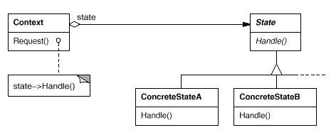
Structure of State pattern

Slide 35
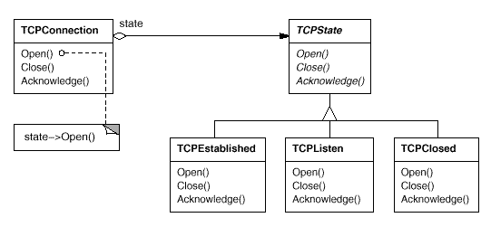
Instance of State Pattern

Slide 36
State Pattern Demo
StatePatternDemo
+main(): void
creates
<<interface>>
Context
-state : State
State
uses
+doAction : void
+Context() : void +getState() : int +setState() : void
implements
StartState
StopState
+doAction() : void
+doAction() : void

Slide 37
State pattern notes
Can use singletons for instances of each state class
State objects don’t encapsulate state, so can be shared
Easy to add new states
New states can extend other states
Override only selected functions

Slide 38
Cohort Exercise
Title: TaxVisitor
Q5. Use the Visitor design pattern, compute the total tax payable on a list of items of the following types: Car, Electronics, Chocolate. The tax is payable under two conditions, whereby two taxing systems are in place:
TaxNormal:
Car: 40%, Electronics: 80%, Chocolate: 20%
TaxHoliday:
Car: 30%, Electronics: 50%, Chocolate: 10%

Slide 39
Sample test class:
public class MyClass { public static void main (String[] args) { ArrayList<Visitable> items = new ArrayList<Visitable>(); TaxVisitor tax = new TaxVisitor("TAXHOLIDAY"); items.add(new Car(100000)); items.add(new Electronics(2000)); items.add(new Chocolate(100)); for (Visitable o : items) { o.accept(tax); }
System.out.print("This is the Tax Visitor program:"); System.out.println (tax.getTotal()); } }
Output:
This is the Tax Visitor program. Total tax:
31010.0

